Slide 1
ADAPTERS
IMAGE ORGANIZER APPLICATION
UNDER THE GUIDANCE OF - Dr. Durgansh Sharma

Slide 2
HTTP ADAPTER
The HTTP adapter sends an HTTP or HTTPS request to a URL and processes the response to return the web page in JSON format.
This adapter does not support multiple configuration nodes..
The HTTP adapter now also supports multi-part file upload.

Slide 3
SQL ADAPTER
The SqlDataAdapter Object and DataSet objects are combine to perform both data access and data manipulation operations in the SQL Server Database.

Slide 4
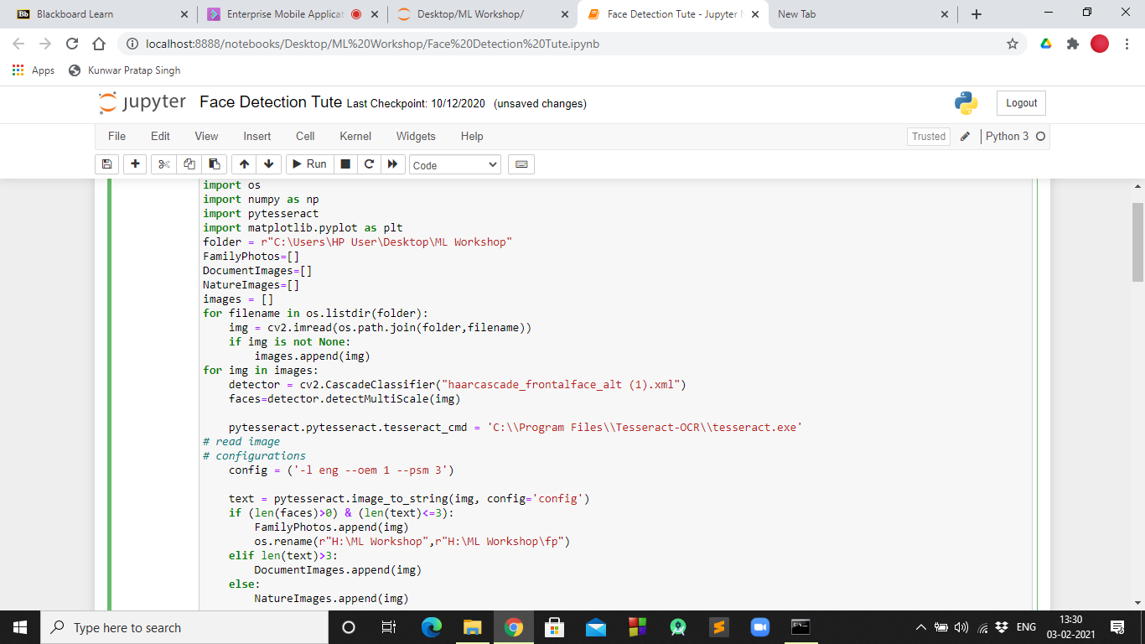
PROGRESS
Till now we have been working on the machine learning algorithm. In the snippet attached alongside you’ll find the execution of the algorithm in jupyter notebook.

Slide 5
Thank You.

